Slide 1
OPA Heuristic ASSESSMENT
IRS.GOV ONLINE SYSTEMS
January 2017
Matt Connors

Slide 2
CONTENTS
Global Considerations 4
Navigation to the OPA 7
SEARCH RESULTS DIRECTED TO THE OPA 13
ALTERNATE OPTIONS SIMILAR TO THE OPA 17
THE OPA DESCRIPTION AND Process 22
ACCESSIBILITY AS IMPLEMENTED for the OPA 30
RELATIONSHIP TO THE PERSONAS 33
CLOSING THOUGHTS AND NEXT STEPS 38

Slide 3
Getting Started
GLOBAL OVERVIEW OF THE OPA TOOL WITHIN IRS.GOV

Slide 4

OVERVIEW OF ASSESSMENT CRITERIA
What WE Looked at
This UX assessment is being presented by members of the Booz Allen Hamilton UX Design team, to conduct a best practices review of the implementation of the Online Payment Agreement within the irs.gov framework, with the goal of identifying potential usability focus points.
What are the expectations of this qualitative assessment? Discover:
How is the OPA tool found by site users?
What are the pathways to learn more about the OPA toolset?
How is the OPA tool described to new users?
Are alternatives to the OPA tool presented clearly to users?
What are the Accessibility options for the OPA tool pages?
How are these OPA tool pages viewed on different devices?
Once in the OPA tool, are the steps clear and concise?
What are the formative goals of this assessment?
To gain a greater understanding of the site architecture and set of decisions for new and returning users
Determine next steps for the OPA tool
Potential to add a footnote or quote in here.
UNDERSTANDING THE NEEDS

Slide 5

OVERVIEW OF ASSESSMENT CRITERIA
The Approach we used
At this stage, the site and tool-specific evaluation is qualitative, objective and singular, compiled by Matt Connors to improve the overall understanding of the OPA tool and its place in the irs.gov framework.
Specific tools used for assessment:
Mac Desktop web access via Google Chrome
Mac OS Zoom and VoiceOver for alternative usability
iOS iPad Mini Tablet web access via Apple Safari
iOS iPhone web access via Apple Safari
How is the assessment objective?
When conducting this assessment, the tester/evaluator had no prior knowledge of the construction of the site, UX strategy, or prior design guidelines. There had also been no prior use of the irs.gov site in its current state by the evaluator.
Potential to add a footnote or quote in here.
ACTION CAPTION

Slide 6
USABILITY FOCUS POINTS
ACCESS TO THE ONLINE PAYMENT AGREEMENT

Slide 7

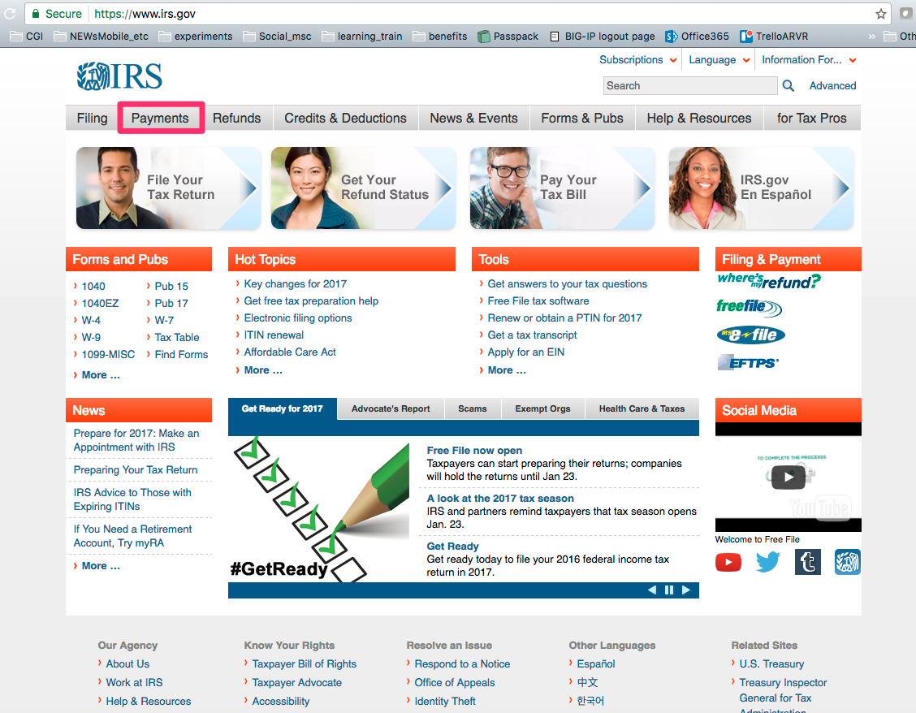
DESKTOP NAVIGATION TO THE OPA
OPA ACCESS FROM THE PAYMENT TABS
The most direct path for users is through the Payments tab on the left side of the homepage
Payments tab leads to the Payment page where the OPA link can be found in Can’t Pay Now (next page) ‘online payment agreement’

Slide 8

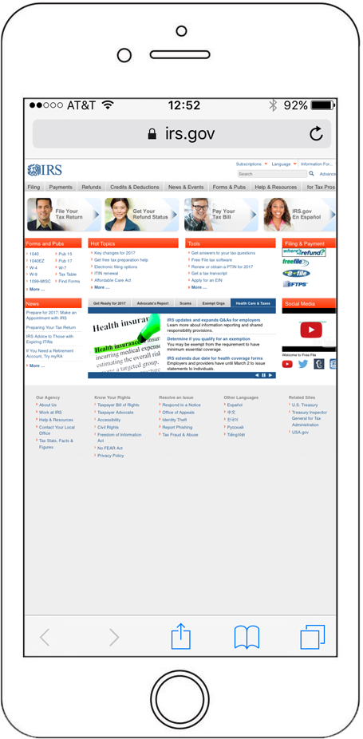
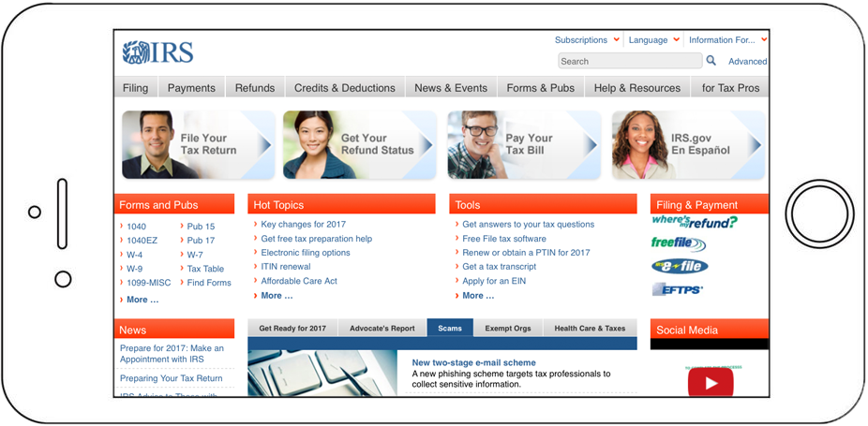
Phone NAVIGATION TO THE OPA
OPA ACCESS FROM THE PAYMENT TABS, MOBILE
Payments tabs may be difficult to locate and read when viewed in portrait view on smaller mobile phones
Landscape format allows nearly double size of text and icons when compared to the portrait view

Slide 9
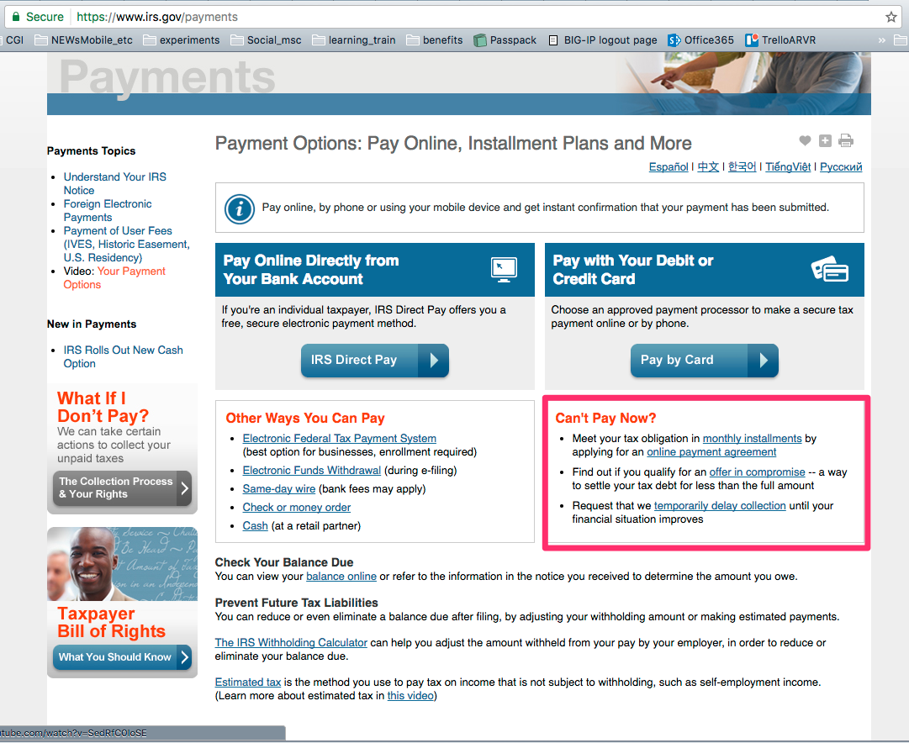
NAVIGATION TO THE OPA
THE ENTRY TO THE OPA
The access to the Online Payment Agreement is found through several touchpoints, as a response to the question posed to the user ‘Can’t Pay Now?’
Can’t Pay Now leads to a direct highlighted link ‘online payment agreement’ to the OPA qualification page

Slide 10
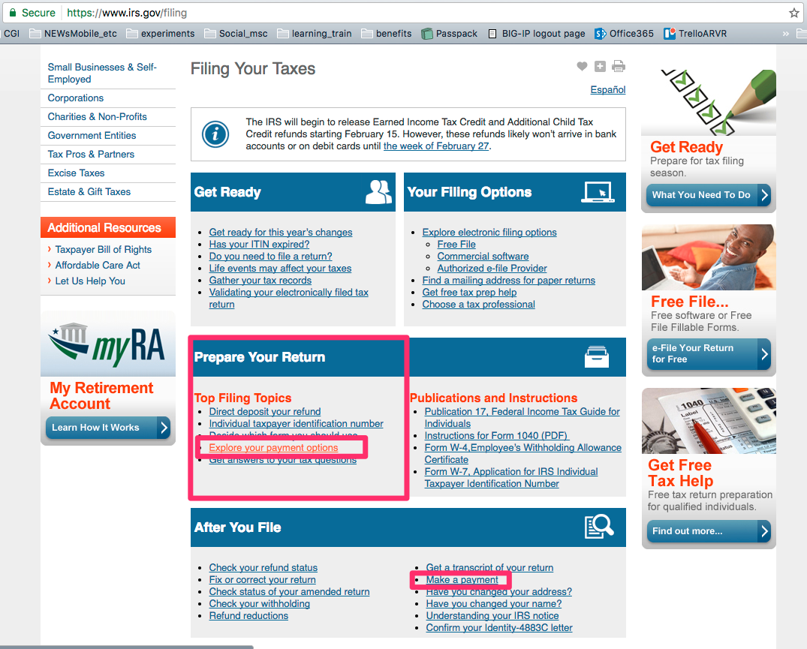
NAVIGATION TO THE OPA
Additional PATHWAYS TO THE OPA
Under the ‘Prepare Your Return’ section
Explore Payment Options links to the Payments page
Make a Payment also links to the Payments page

Slide 11
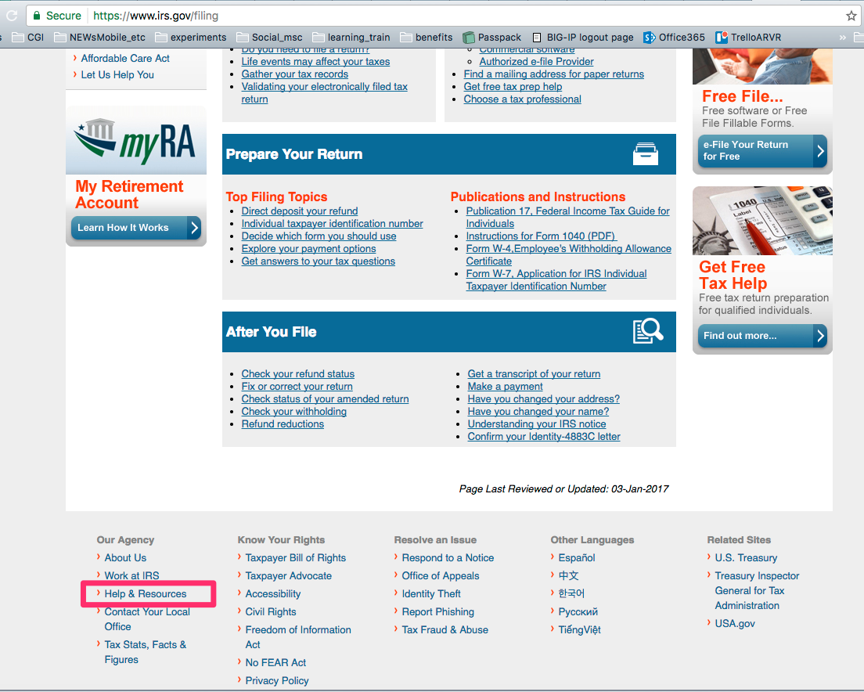
NAVIGATION TO THE OPA
ADDITIONAL PATHWAYSTO THE OPA
The access to the Online Payment Agreement is found through several touchpoints
Help and Resources also provides an indirect pathway to the OPA

Slide 12
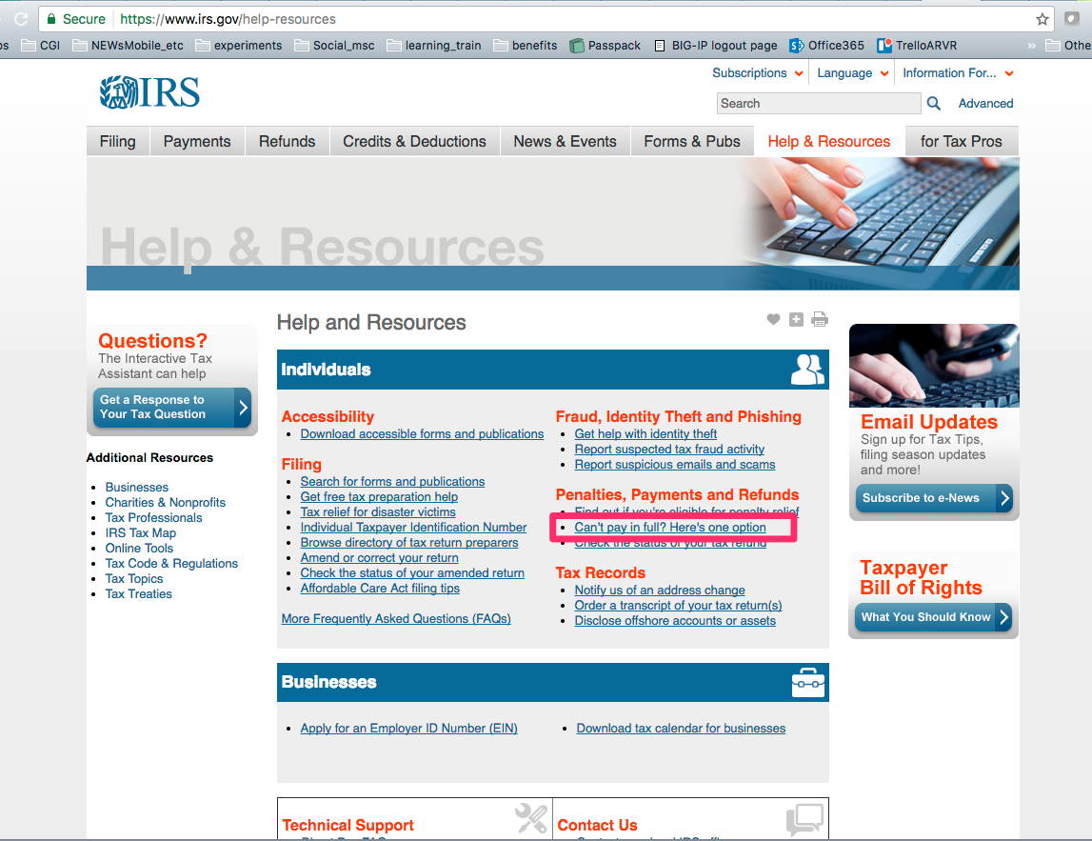
NAVIGATION TO THE OPA
THE ENTRY TO THE OPA
The access to the Online Payment Agreement is found through several touchpoints
Payments, Penalties and Refunds links directly to the OPA

Slide 13
NAVIGATION TO THE OPA
THE ENTRY TO THE OPA
The access to the Online Payment Agreement is found through several touchpoints
Can’t Pay Now leads to a direct link to the OPA

Slide 14
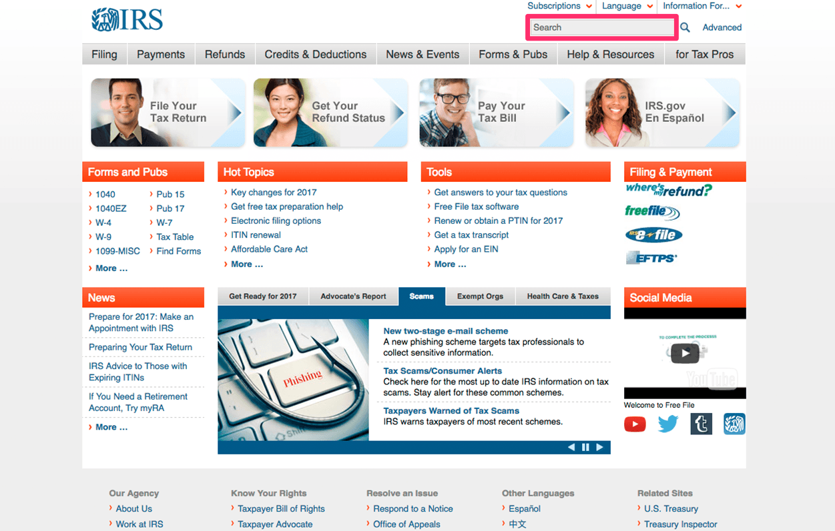
SEARCH for OPA on IRS.GOV
USING THE DESKTOP SEARCH FEATURES
The access to the Online Payment Agreement is found through several touchpoints
Can’t Pay Now leads to a direct link to the OPA

Slide 15

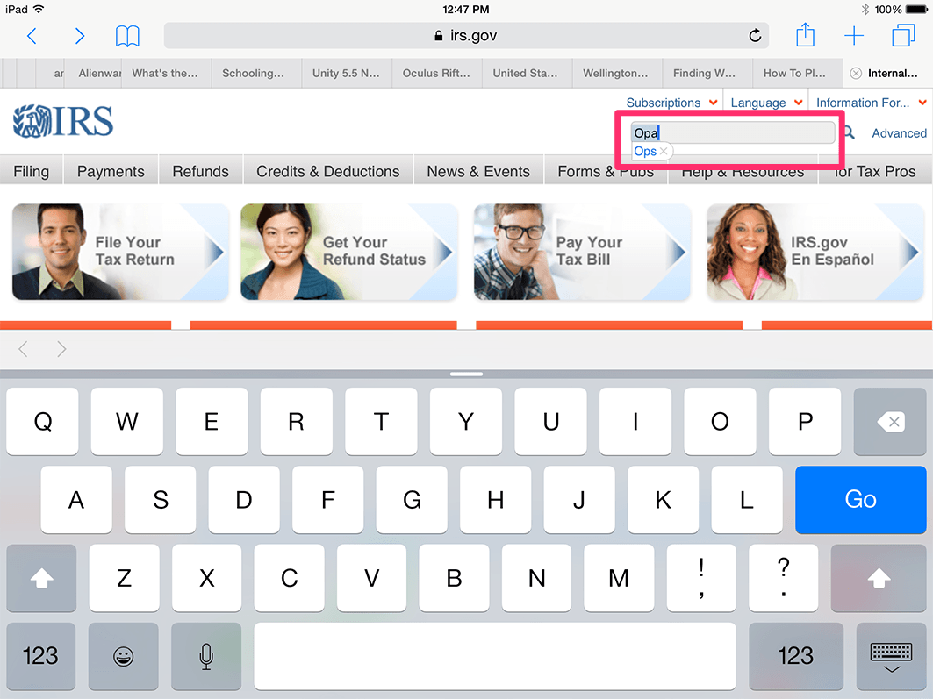
SEARCH for OPA on IRS.GOV
USING THE IOS TABLET SEARCH FEATURES
The access to the Online Payment Agreement is found through several touchpoints
Can’t Pay Now leads to a direct link to the OPA

Slide 16
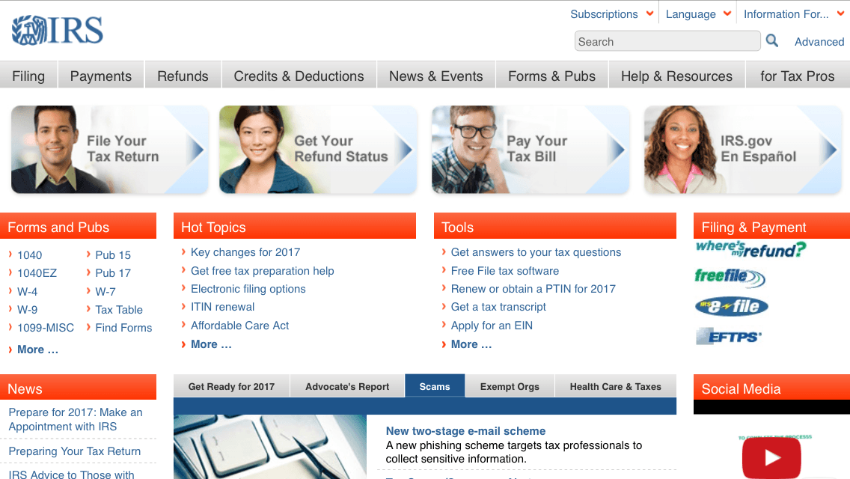
SEARCH for OPA on IRS.GOV
USING THE IOS PHONE SEARCH FEATURES
Readability is affected when the pages are viewed on smaller phones such as the iPhone 5
Search area difficult to see at this scale

Slide 17
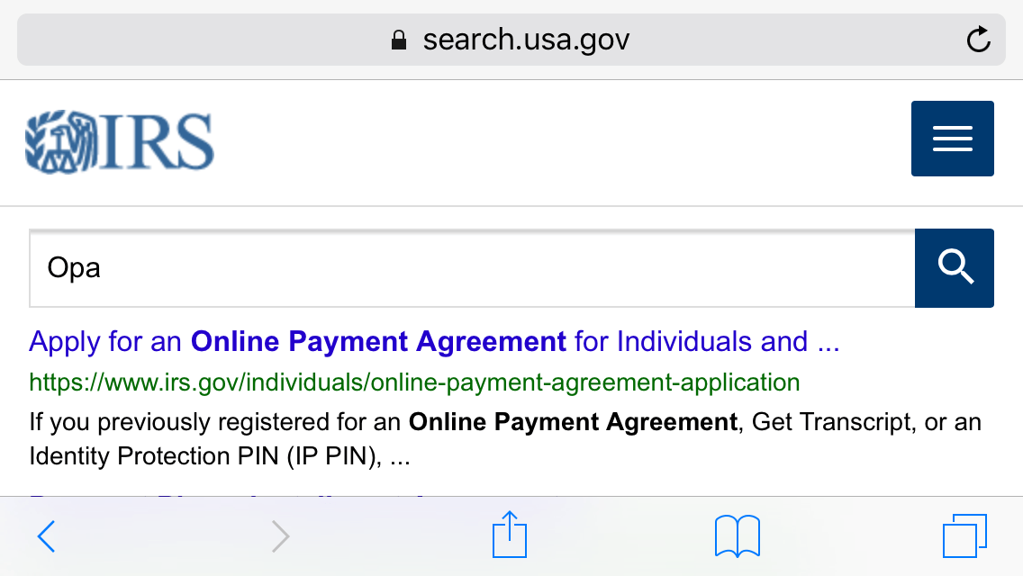
SEARCH for OPA on IRS.GOV
USING THE IOS PHONE, SEARCH RETURNS
Available screen real estate not optimized due to the size of the IRS logo
Scrolling not clearly indicated

Slide 18
SIMILAR TOOLS
TO THE OPA ALSO FOUND ON IRS.GOV

Slide 19
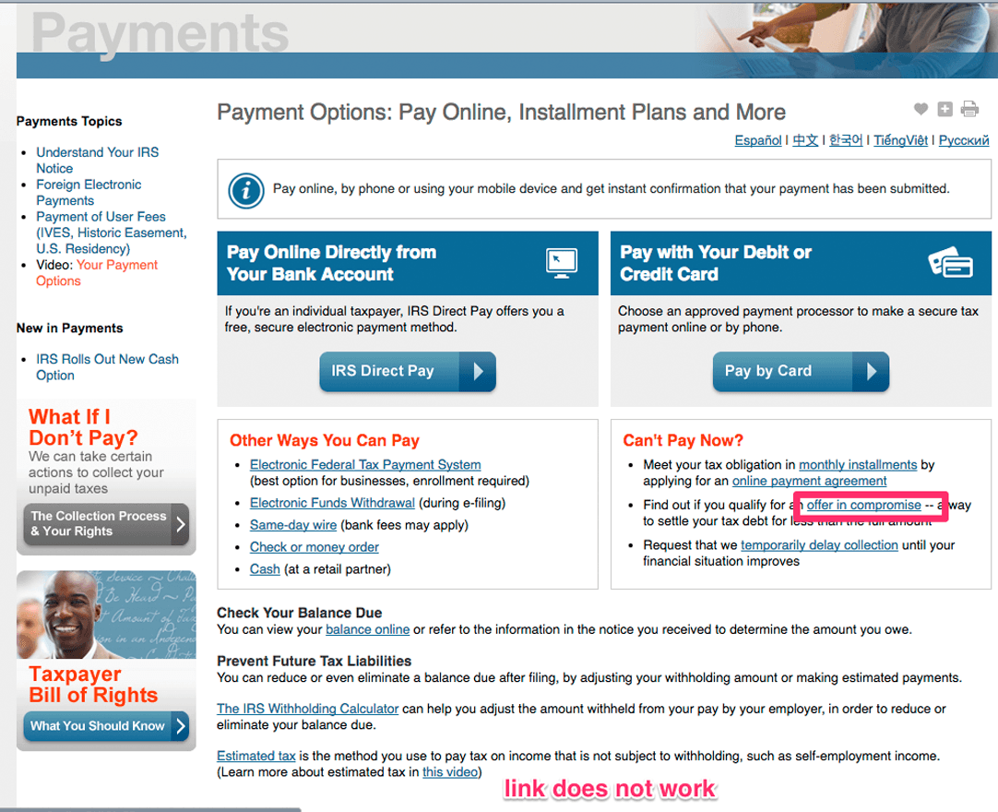
SIMILAR TOOLS to the OPA
OFFER IN COMPROMISE
Compromise amount for less than the amount due tax payment based on pre-qualification
Lump sum or periodic payment

Slide 20
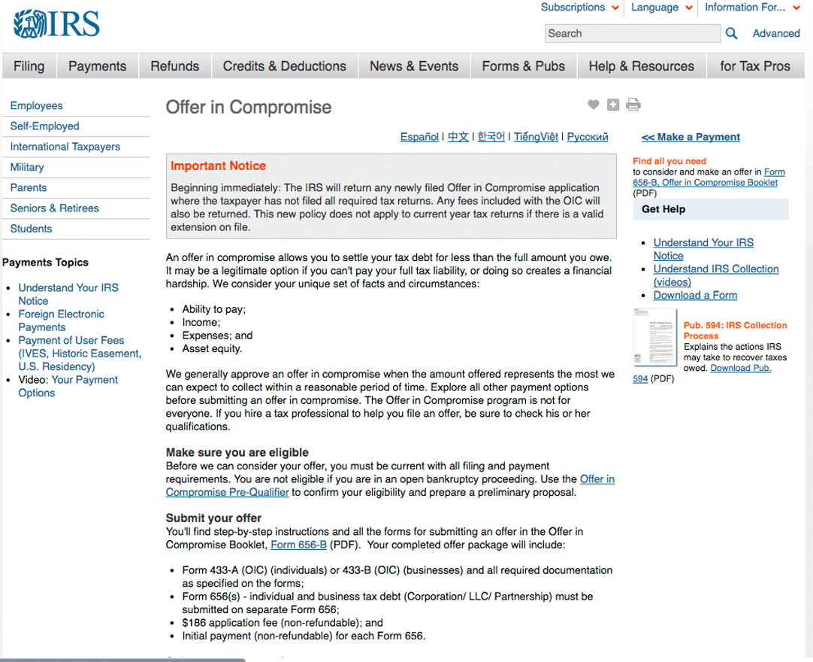
SIMILAR TOOLS to the OPA
OFFER IN COMPROMISE (detail page)
Compromise amount for less than the amount due tax payment based on pre-qualification
Compromise Pre-Qualifier

Slide 21
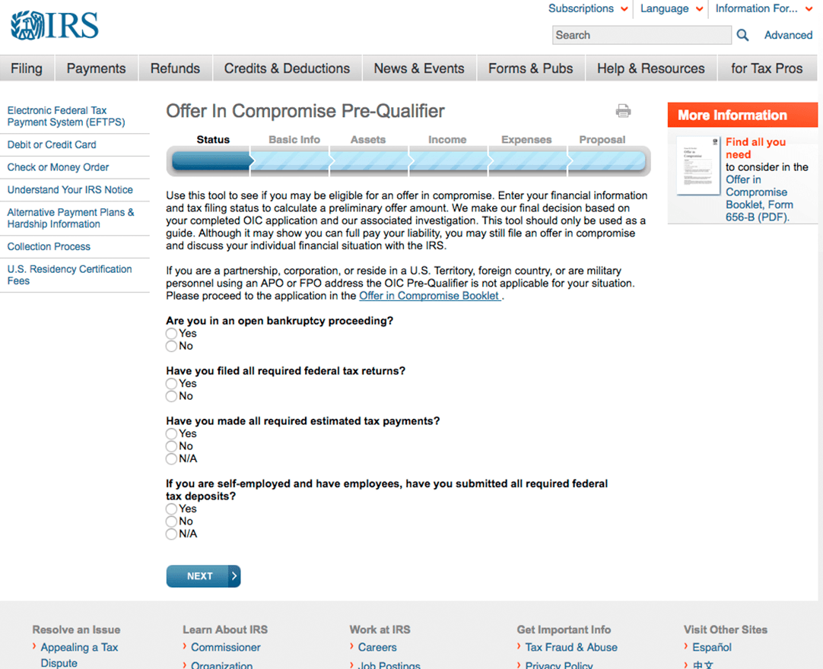
SIMILAR TOOLS to the OPA
OFFER IN COMPROMISE Pre-Qualifier
6-step process to complete pre-qualification
Radio buttons for ease of use
Tabs on top of page show progress

Slide 22
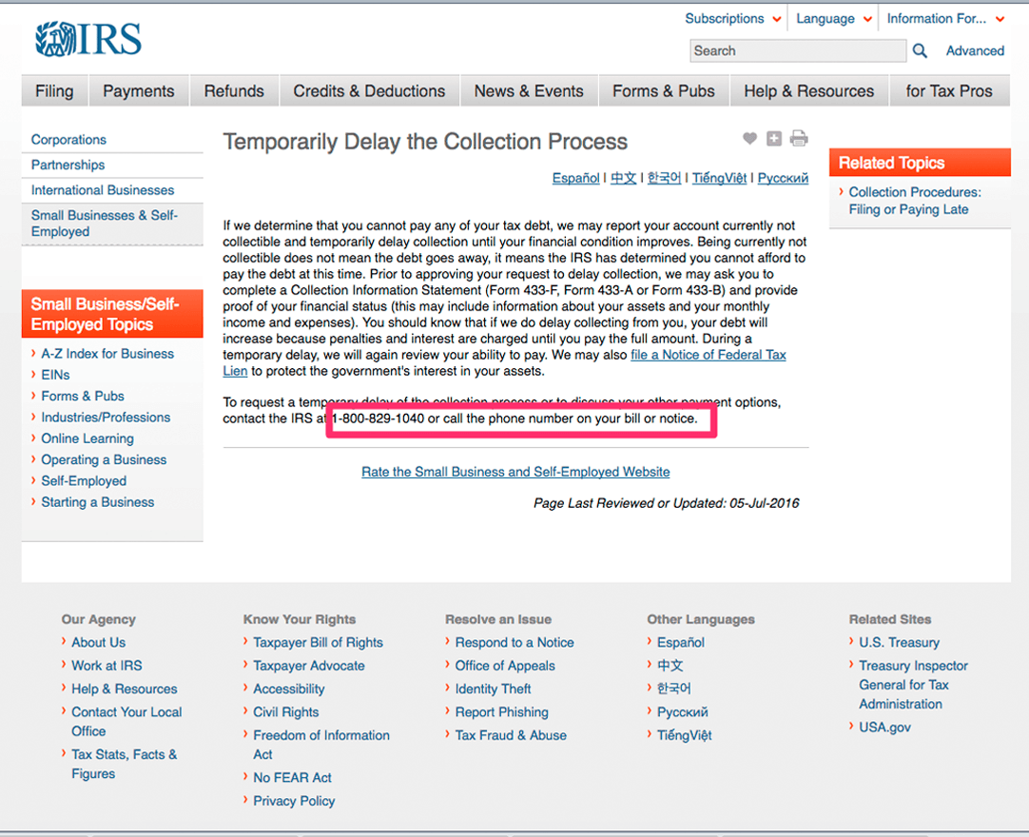
SIMILAR TOOLS to the OPA
Temporary Collection Delay
Deferment but not debt reduction, based on current and future financial status
Includes a hotline number to call

Slide 23
THE OPA
USER PROCESS TO COMPLETE

Slide 24
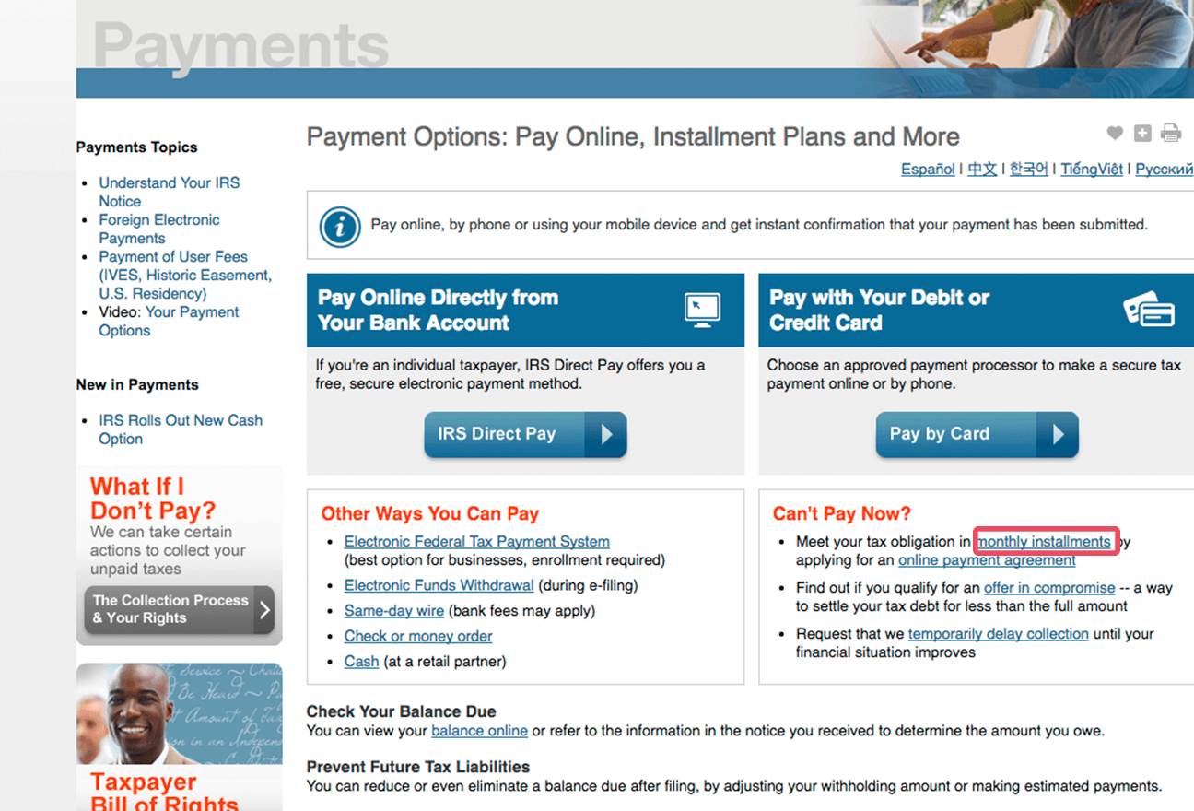
Online Payment Agreement
Monthly InsTallments
Upfront information about the OPA
Followed by an action statement to the user ‘Meet your tax obligation’
Precursor to the OPA link itself

Slide 25
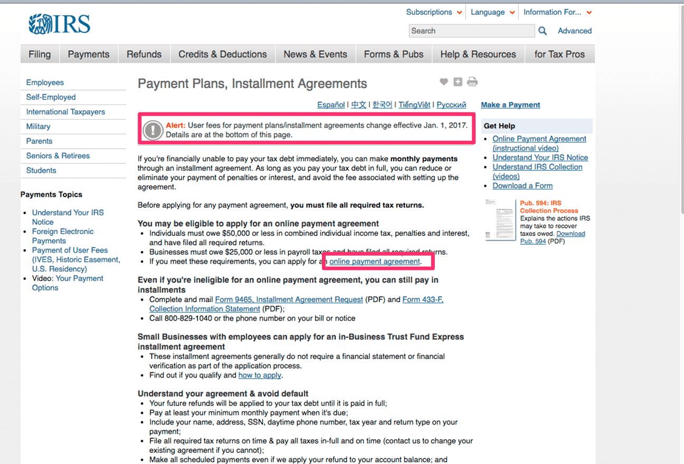
Online Payment Agreement
Monthly InsTallments
Payment Plans and Installation Agreements
User Fees Detail at top of page, details at bottom
Link back to OPA in first bulleted section

Slide 26

Online Payment Agreement
OPA ENTRY From ‘CAN’t PAY NOW?’
Direct access to the OPA tool
Described briefly as an application process
Related tools listed below: ’offer in compromise’ and ‘temporary delay collection’

Slide 27
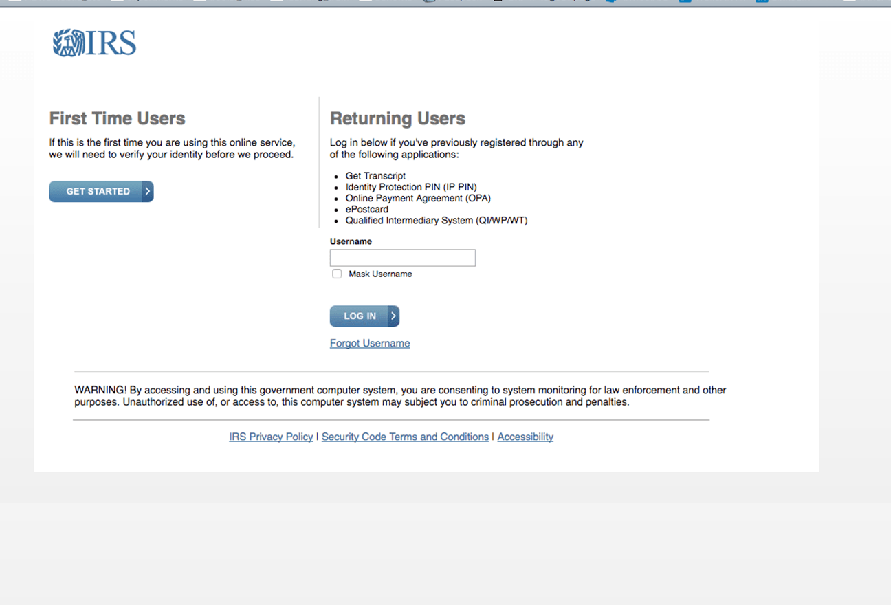
Online Payment Agreement
Initial Page FOR THE OPA
First time users and returning user page
First time users information in concise
Returning users information requires additional information

Slide 28
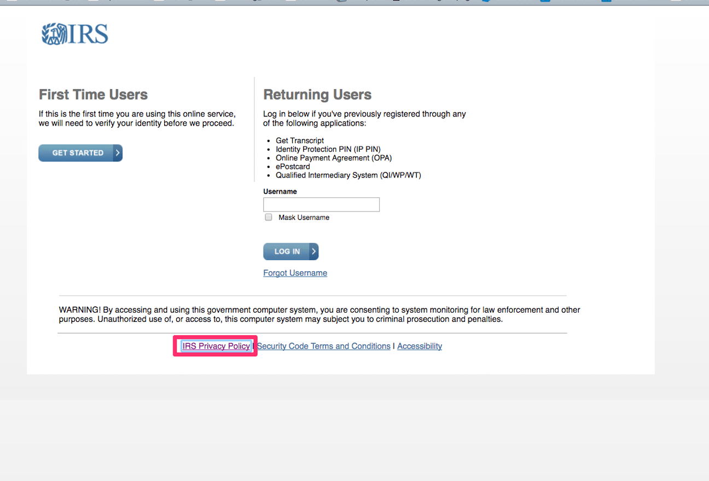
Online Payment Agreement
Initial Page FOR THE OPA
IRS Privacy policy and other links at the bottom of the page don’t make it clear that the pages will open on new pages:
IRS Privacy Policy open as its own tab
Security Code opens as a new window
Accessibility opens as a new window

Slide 29
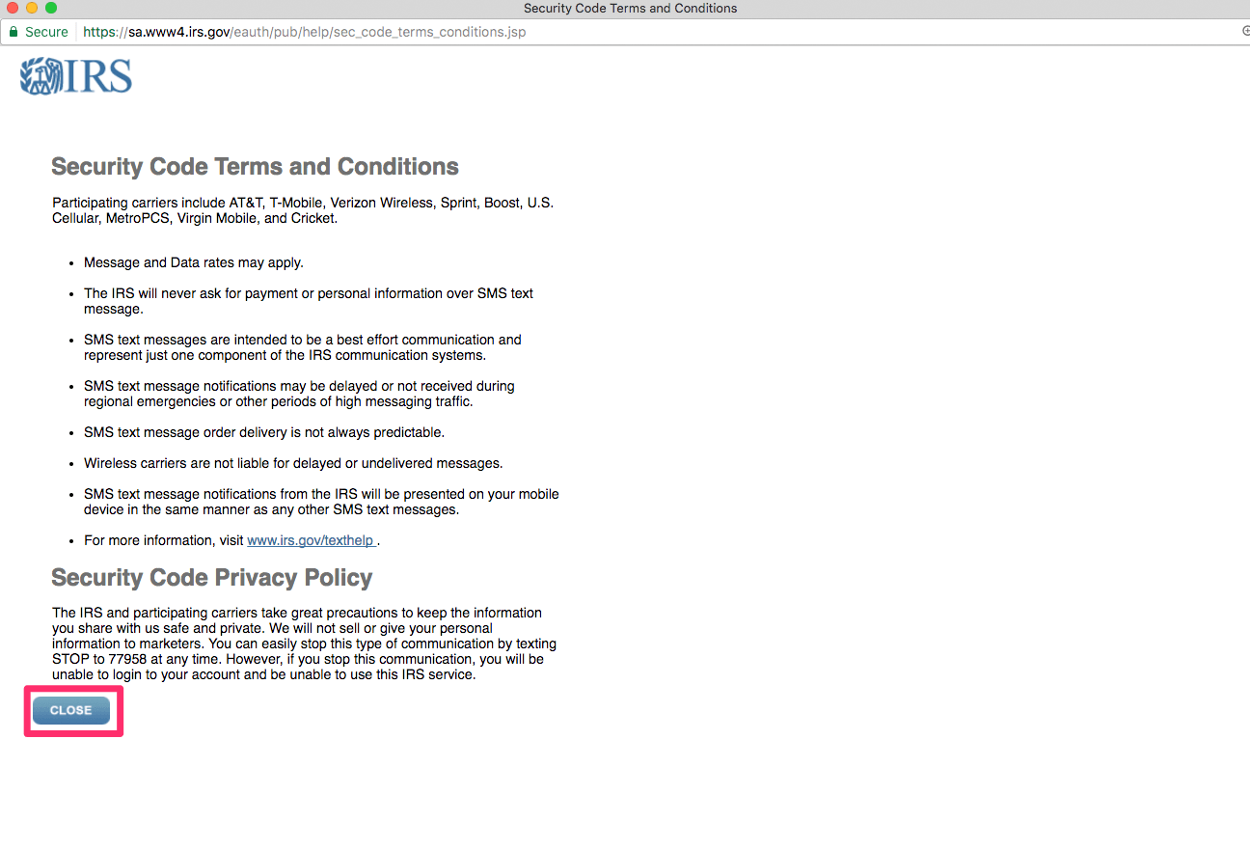
Online Payment Agreement
Security Policy page for the OPA
The security policy opens as its own window
When window is closed with the button at the bottom left the user returns to the initial page for the OPA

Slide 30
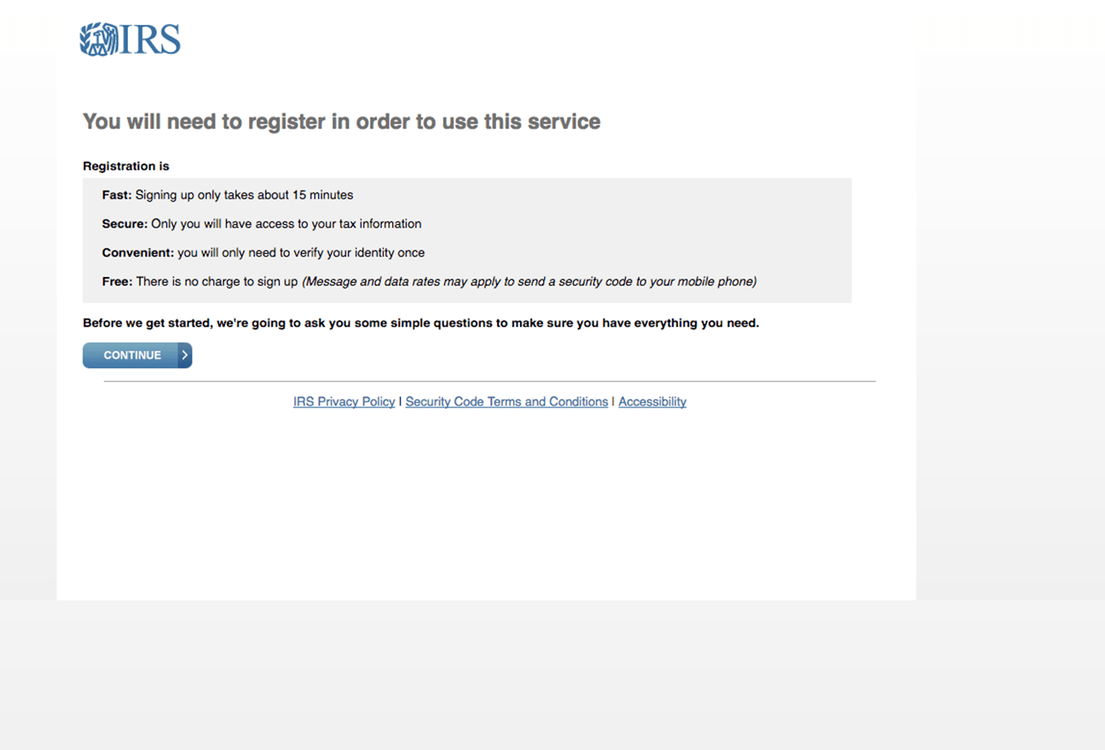
Online Payment Agreement
OPA Page TWO
Notice of registration
Clearly indicates the estimated time for completion
Also indicates security, one-time submission, and cost is free
Clear notice that more information will be requested

Slide 31
ACCESSIBILITY
ALTERNATE ACCESS OF THE OPA TOOL WITHIN THE IRS.GOV

Slide 32
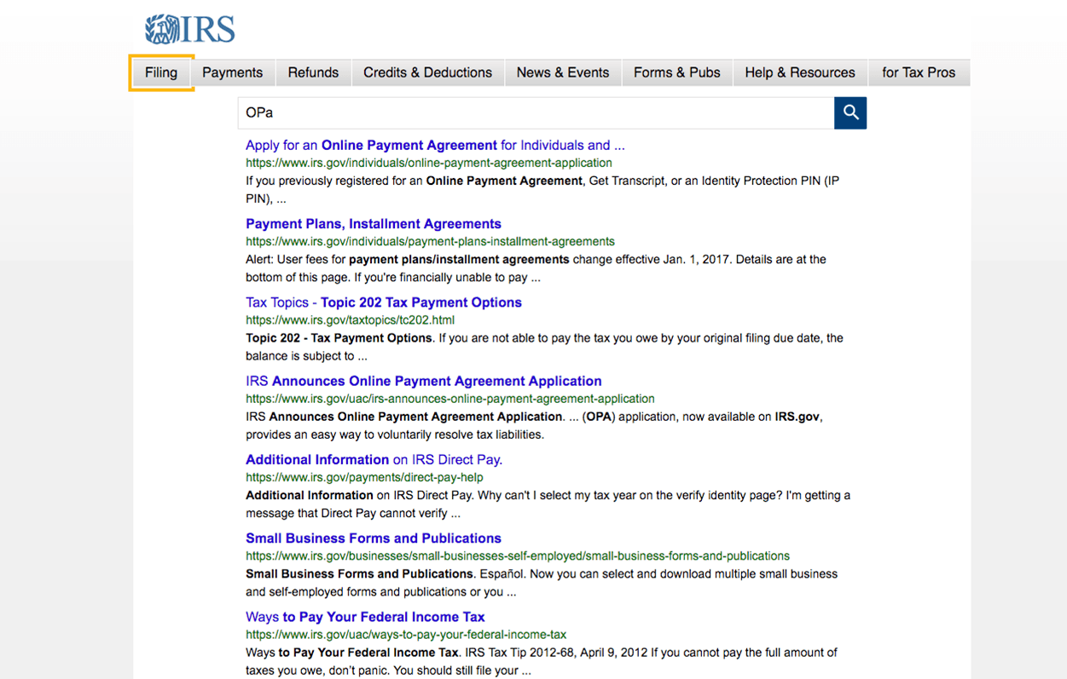
KEYBOARD ACCESS TO SEARCH
KEYBOARD-ONLY ACCESS
On the search page from the main page, Tabbing via the keyboard through the fields allows the user to move through the top bar of options, and navigate into the search field and the search retuen.
HOLD ON THIS-DEFER TO ACCESSIBILITY SPECIALIST

Slide 33
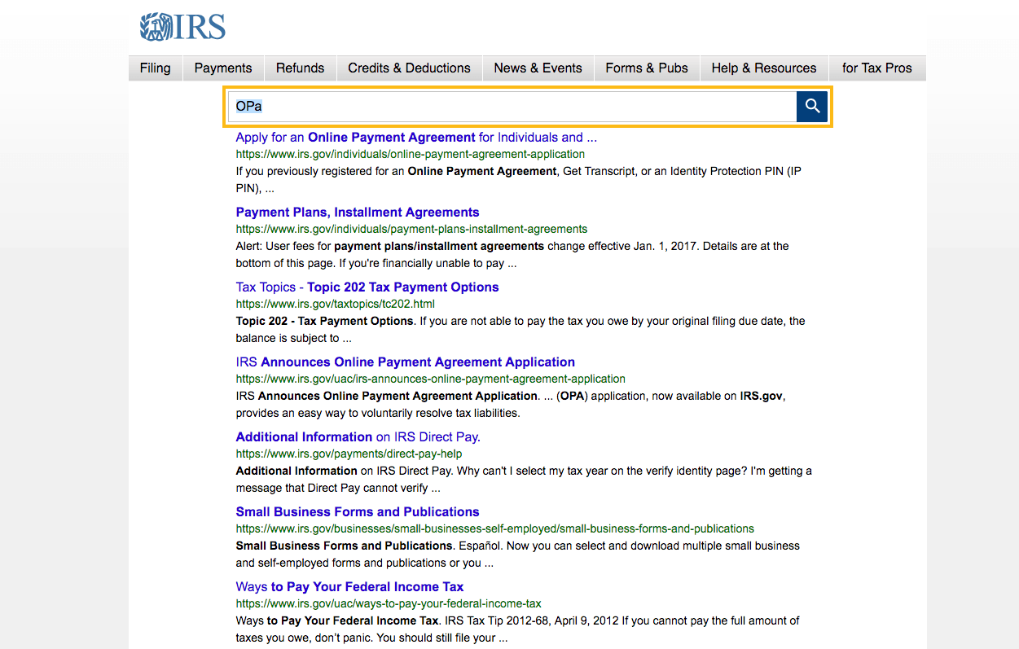
KEYBOARD ACCESS TO SEARCH
KEYBOARD-ONLY ACCESS
The keyboard tab does not allow users to directly select any of the search returns. This can only be done with a mouse.
HOLD ON THIS-DEFER TO ACCESSIBILITY SPECIALIST

Slide 34
PErsonas
RELATIONSHIP TO THE USER FLOW

Slide 35
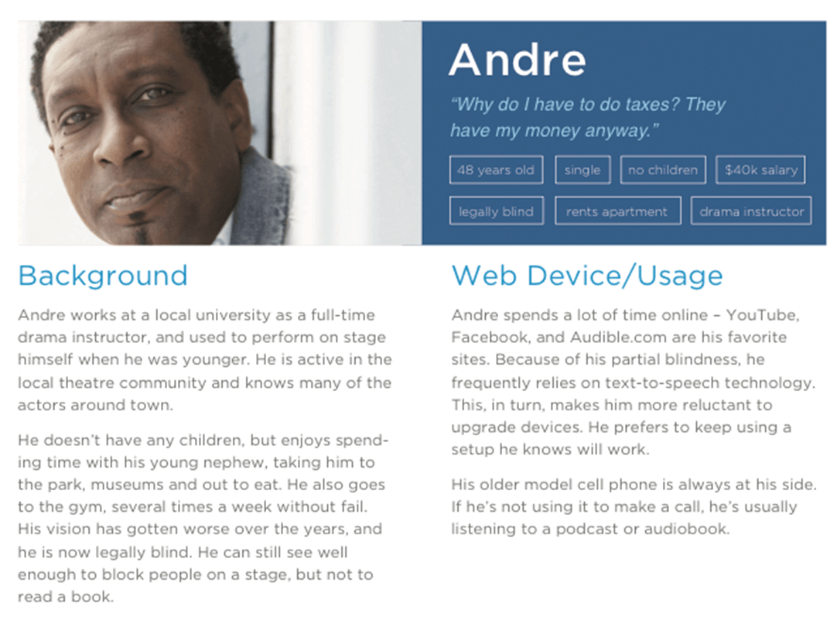
Personas: ANDRE
ACCESSIBILITY and CLEAR INSTRUCTIONS
Uses text to speech due to partial blindness and an older model phone
ADDITIONAL PERSONAS TO BE ADDDED

Slide 36
NEXT STEPS
THE OPA TOOL WITHIN THE IRS.GOV

Slide 37
TAKEAWAYS
WE NEED MORE INFORMATION ON USER DECISIONS
This assessment was created without access to data on past and present user information or history of the OPA’s structure and revisions. Next steps would include more access to data before proposing potential solutions.
Methods of approach to the OPA?
Devices used for the OPA?
What was the design methodology?
What is the data on participation to conversion of the agreement?
What is the percentage of return users?
What are the most common questions?
What are the most common problems?

Slide 38
BIG HEADLINE
Big intro text goes here. This can be one paragraph or a couple of short paragraphs. There should be white space around the paragraph so don’t fill up the page. Big intro text goes here. This can be one paragraph or a couple of short paragraphs. There should be white space around the paragraph so don’t fill up the page. Big intro text goes here. This can be one paragraph or a couple of short paragraphs. There should be white space around the paragraph so don’t fill up the page. Big intro text goes here. This can be one paragraph or a couple of short paragraphs. There should be white space around the paragraph so don’t fill up the page.

Slide 39
Process Flow
Data (I/O)
Predefined Process
Process
Decision
Yes
Process
Decision
Yes
Multiple Documents
No
No
Data (I/O)
Document
Data (I/O)
Arrange, add, or delete process objects as need
Use the built in alignment keys to maintain a clean layout

